Slide 1
COMPUTER SCIENCE PROJECT II-CS692
CLASS NAVIGATOR GUIDANCE BY-PROF HENRY WONG
Our GitHub Link-
https://github.com/CS691team3/CS691team3project
Our Wiki page link-
https://github.com/CS691team3/CS691team3project/wiki
Team Members
1. Ameya Kherodkar
2. Chinmay Joshi
3. Kenneth Okereke
4. Shivam Mattoo

Slide 2
Introduction
Class navigator is an app which will navigate students ,faculty, visitors to their respective destinations in university campus
It navigates users within the school facility using certain images
It will be a cross platform mobile application
This app will provide elegant, aesthetically pleasing panoramic tour to our university

Slide 3

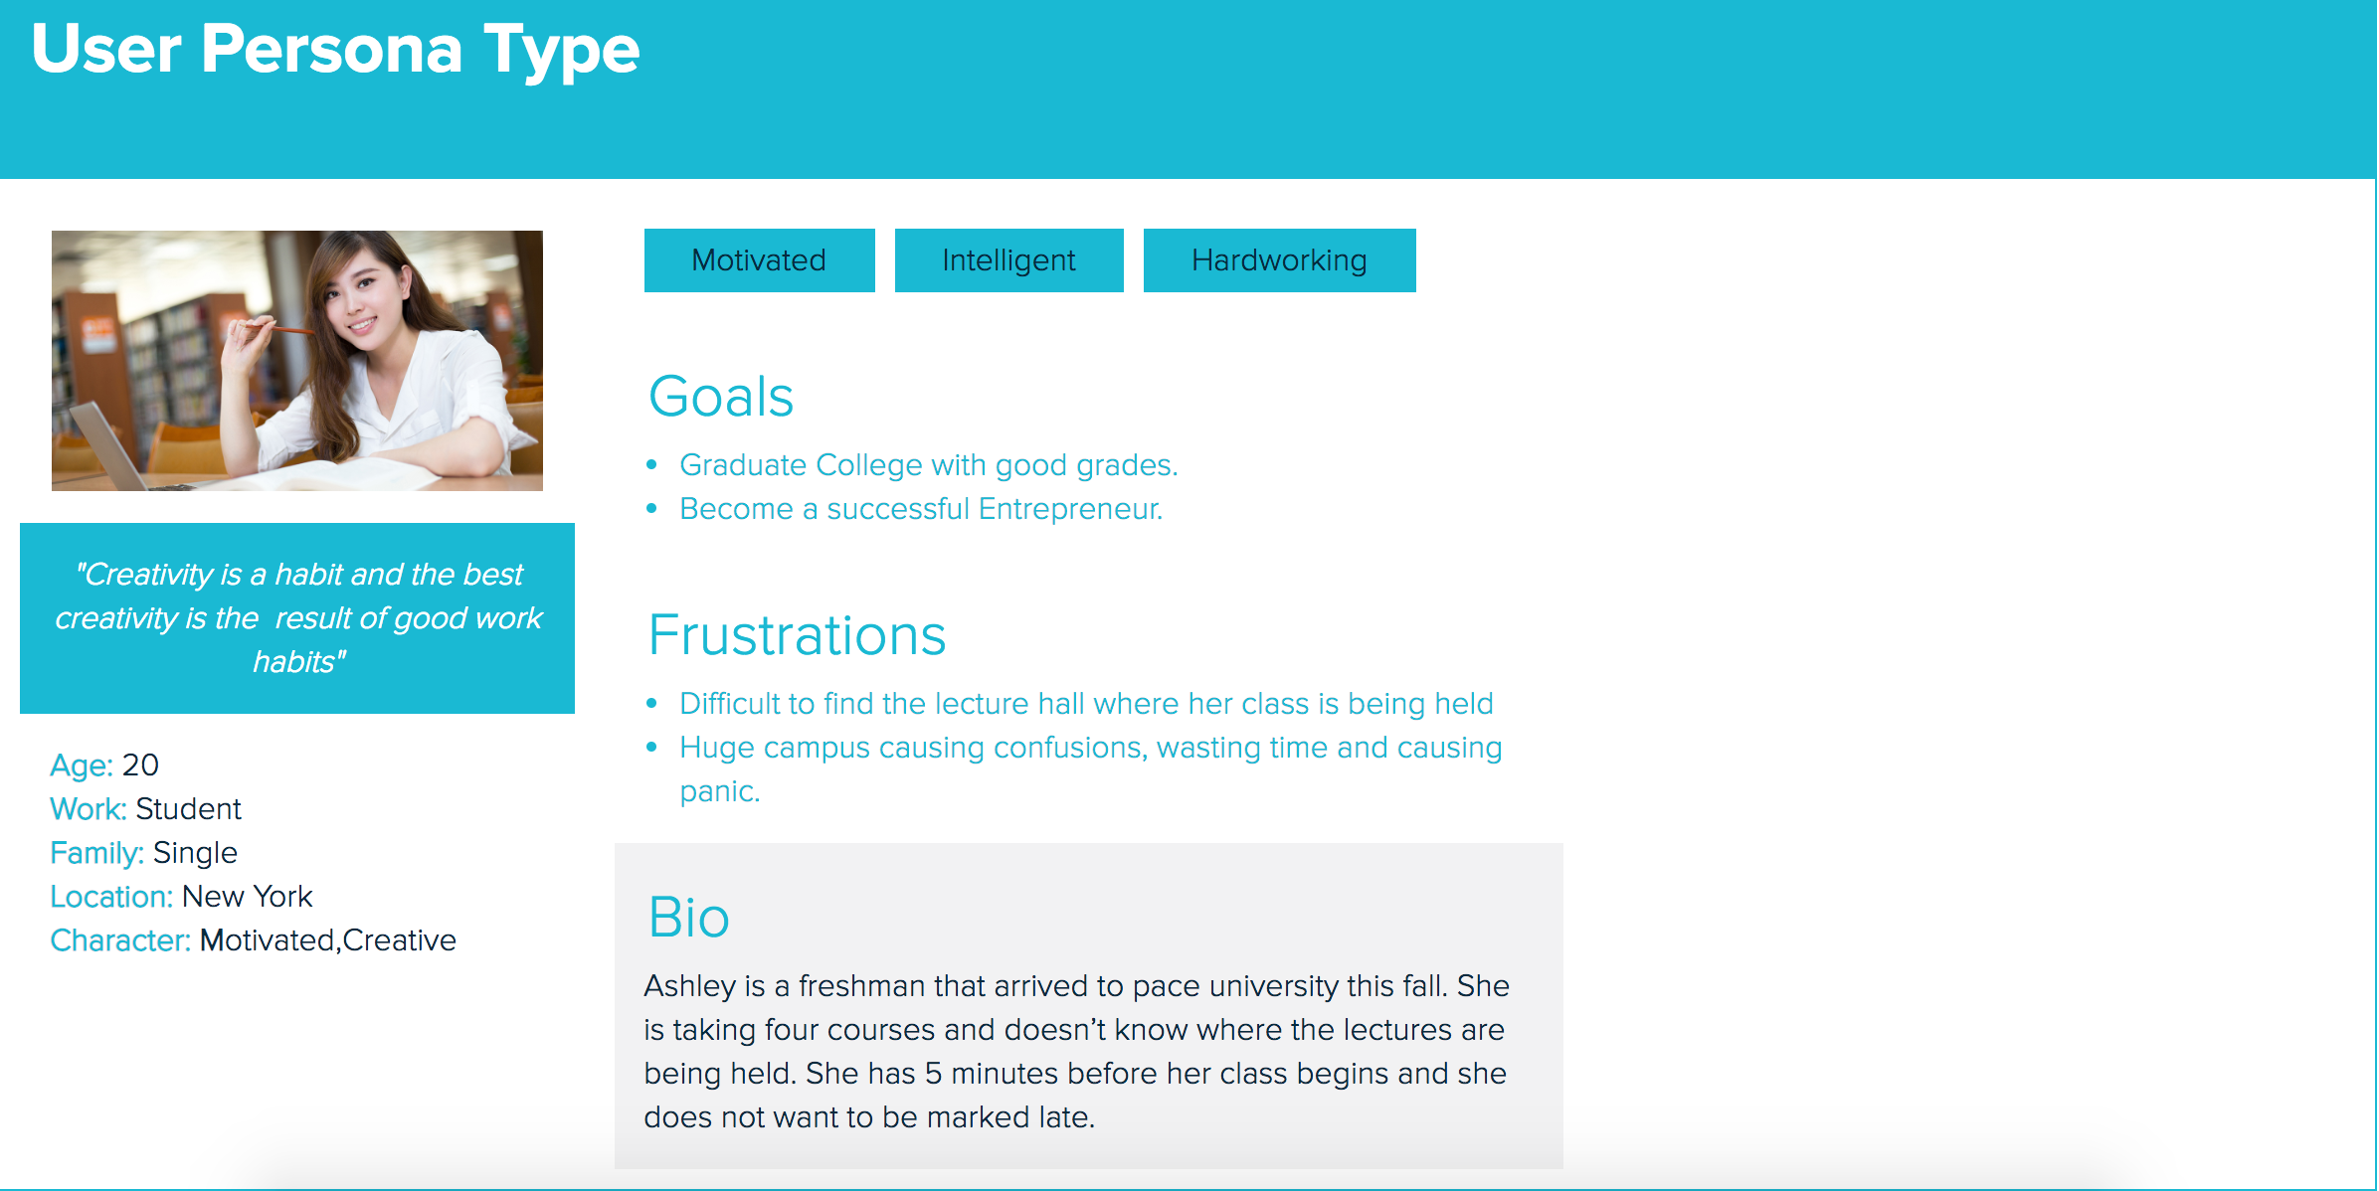
Persona # 1

Slide 4
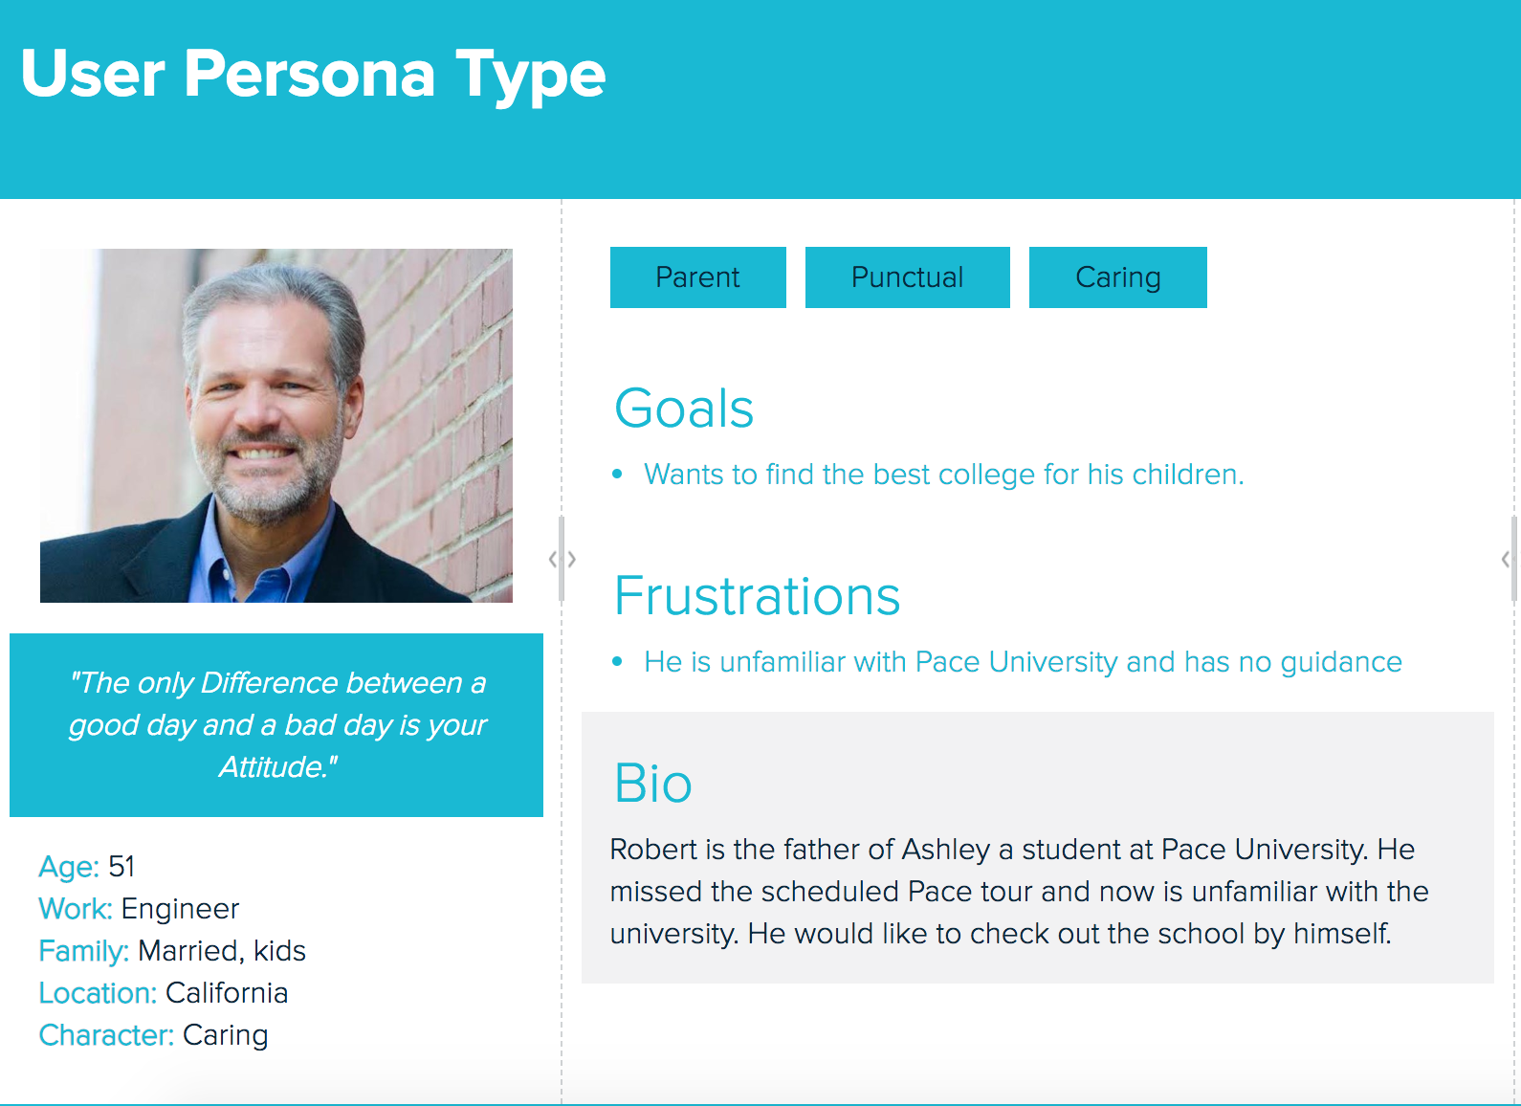
Persona # 2

Slide 5
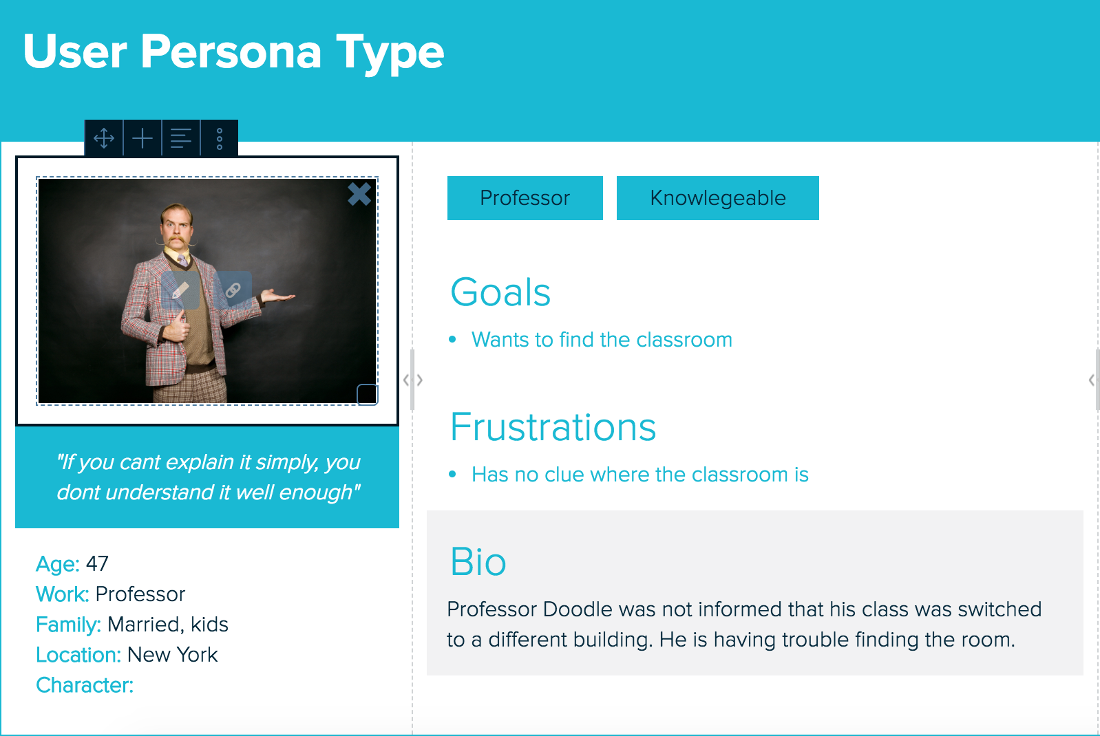
Persona #3

Slide 6


Sprints
Sprint 1
UI development and Gathering images and Videos
Sprint 2
Extracting Images from Videos ,Training dataset and developed Application to provide path search implementation
Sprint 3
Backend Implementation using SQLite and Integrating Backend with our Application
Implementing DCNN trained model with our application along with the database to deploy final version of our project
Sprint 4

Slide 7
SPRINT 1
Gathering Images and Videos for our Project to train dataset.
Start Application Development(UI) for both iOS and Android.

Slide 8
SPRINT 1 User stories
User Stories | Module | Status
User Story 1 | Sign-Up Module | Completed
User Story 2 | Login Module | Completed
User Story 3 | Forgot Password | Completed
User Story 4 | Logout Module | Completed

Slide 9
SPRINT 2
Extracting Images from Videos for our Project to train dataset.
Start Application Development(Initial Phase) for both iOS and Android.

Slide 10
SPRINT 2 User stories
User Stories | Module | Status
User Story 1 | Search Module | Completed
User Story 2 | Trained Dataset Module | Incomplete

Slide 11
SPRINT 3
Developing Backend for our Application using SQLite in Android Studio.
Storing Trained Data Sets in Backend for Image Recognition
Integrating Backend with our Application for both iOS and Android.
Adding Augmented Reality to our application

Slide 12
SPRINT 3 User stories
User Stories | Module | Status
User Story 1 | Trained Dataset module | Completed
User Story 2 | Camera module | Completed
User Story 3 | AR module | Completed
User Story 4 | Database module | Incomplete

Slide 13
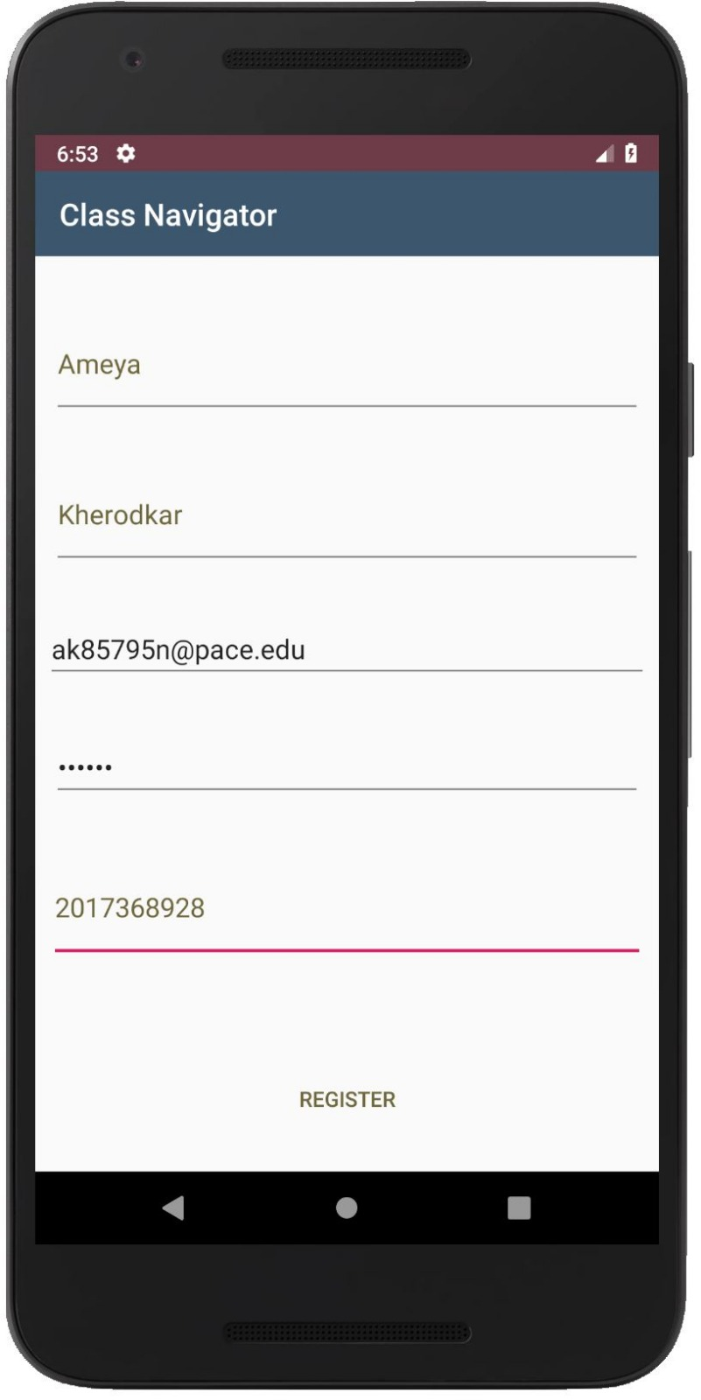
Sprint1 USER STORY: 1 Sign-Up Module | Completed Story Points: 2 Task: Creating Sign-up page in android and IOS Assigned: Ameya and Kenneth AS A FIRST TIME USER I WANT TO BE ABLE TO SUCCESSFULLY SIGN UP FOR THE APPLICATION SO I CAN LOGIN INTO MY APPLICATION
ACCEPTANCE CRITERIA
Enter Valid Username Enter valid Email Enter valid Password Enter valid Contact Number

Slide 14
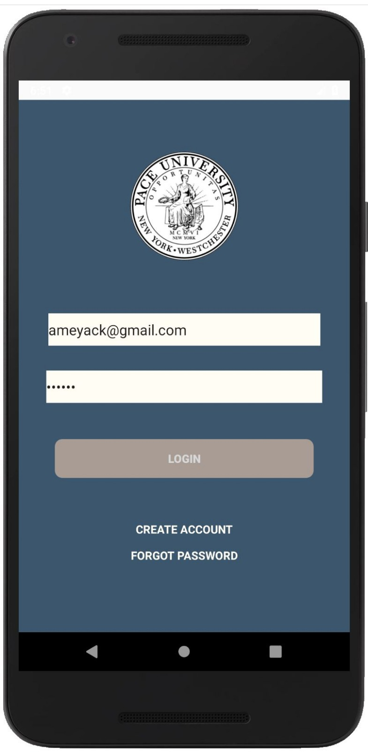
Sprint 1 User Story: 2 Login Module | Completed Story Points: 2 Task: Creating Login page on android and IOS Assigned: Ameya and Kenneth As a Valid user I want to be able to successfully login into the Application so I can Start using my application
ACCEPTANCE CRITERIA
Login with valid Username/Email Enter valid Password Login

Slide 15
Sprint 1 User Story: 3 Forgot Password Module | Completed Story Points: 2 Task: Creating forgot password page on android and IOS Assigned: Chinmay and Shivam As a Valid user I WANT TO be able to successfully retrieve my password so I can login into my Application
ACCEPTANCE CRITERIA
Enter valid Username/Email

Slide 16
Sprint 1 User Story: 4 Logout Module | Completed Story Points: 2 Task: Creating logout page on android and IOS Assigned: Chinmay and Shivam As a Valid user I WANT TO be able to successfully logout so I can go back to login screen and login again with same or different account
ACCEPTANCE CRITERIA
Press logout

Slide 17
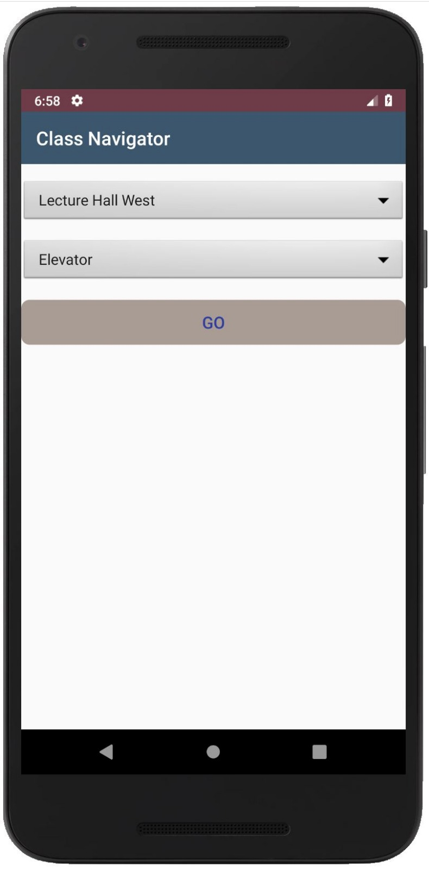
Sprint 2 User Story: 5 Selection Module | Completed Story Points: 2 Task: Creating selection module to select source and destination Assigned: Ameya and Kenneth As a Valid user I WANT TO be able to successfully Select my Starting and final location so I can search for my destination
ACCEPTANCE CRITERIA
Valid start location valid destination

Slide 18
SPRINT2 User Story: 6 Trained Dataset Module | Incomplete Story Points: 3 Task: Training the dataset using DCNN Assigned: Chinmay and Ameya As a Trained Dataset I WANT TO BE able to successfully train and label images so I can help in image recognition
ACCEPTANCE CRITERIA
Valid Dataset valid Labelled images

Slide 19
SPRINT 3 User Story: 7 camera Module | Complete Story Points: 3 Task: To inbuild camera app with android and iOS to recognize objects Assigned: Shivam and Kenneth As an application I WANT TO BE able to open camera application upon clicking go so I can help user navigate to his destination
ACCEPTANCE CRITERIA
Valid source location Valid destination location

Slide 20
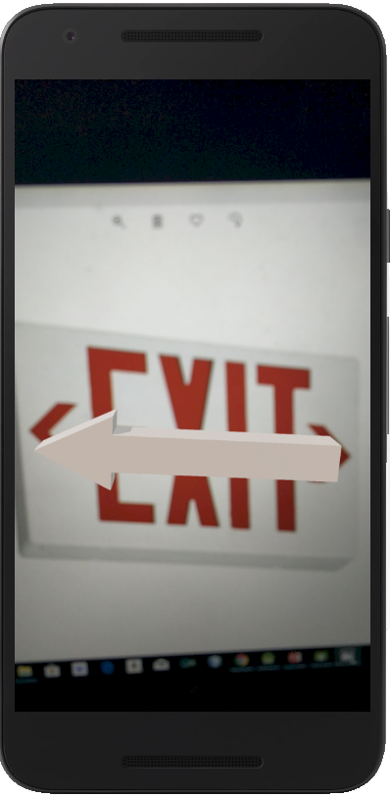
SPRINT 3 User Story: 8 AR Module | Complete Story Points: 3 Task: Implementing Augmented reality in app Assigned: Chinmay and Kenneth As an Application I WANT TO BE able to display AR objects so I can successfully point user towards the right direction
ACCEPTANCE CRITERIA
Clear object/image

Slide 21
SPRINT 3 User Story: 9 Search Module | Incomplete Story Points: 3 Task: Creating search module in app Assigned: Ameya and Shivam As a Valid user I WANT TO BE able to get directions so I can successfully reach to destination from source/ start location
ACCEPTANCE CRITERIA
Valid source location Valid destination location

Slide 22
SPRINT 3 User Story: 10 database Module | Incomplete Story Points: 3 task: Creating database to store all the images for the app Assigned: Chinmay and Kenneth As a database I WANT TO BE able to successfully store and retrieve data and images so I can help in maintain records, authentication and image recognition
ACCEPTANCE CRITERIA
Source and Destination can not be Same

Slide 23
SPRINT 4 User Story: 11 Navigation Module | complete Story Points: 4 task: Creating class navigator app to locate locations Assigned: Ameya and Chinmay As a user I can navigate to my entered destination through android/ios app
ACCEPTANCE CRITERIA
Enter valid user details

Slide 24
Sprint 4
Developed Class Navigator app
Completed Backend for our Application
Minor Upgrades to Application
Integration Testing
Project deployment

Slide 25
Test Cases
Test Case Id | Test case Name | Test case description | Expected Result | Status
1. | User Registration/signup | New Users click on signup to be redirected to signup page | Users get redirected to signup page | Positive
2. | Creating Account | User enters account information like name, email, phone number, username and password | Signup complete | Positive
3. | Phone number | User enters numbers | Phone number accepted | Positive
4. | Phone number | User enters characters | Please enter a valid phone number | Positive
5. | Password | User enters a password less than 6 digits | Please enter a password 6 digits or greater | Positive
6. | Login | User enters correct username and password | Login successful user gets redirected to his account | Positive

Slide 26
Test Cases
Test Case Id | Test case Name | Test case description | Expected Result | Status
7. | Login | User enters incorrect username or password | Login failed please try again | Positive
8. | Search | User clicks on the search button | Camera Opens | Positive
9. | Log out | User selects log out | Successfully logged out redirected to login page | Positive
10. | Search | User search for the source and destination | User selected source and destination | Positive
11.
12.
13.

Slide 27
Steps we use to extract images from videos
Video fisheye distortion correction for all videos, and convert video format to 480p@30fps
Extract images from all frames of the video and rescale to 256×256;
Remove low quality images with blur indicator less than 0.45
Randomly split the dataset into two: 300 images from each category as validation dataset, and use the rest as training dataset

Slide 28
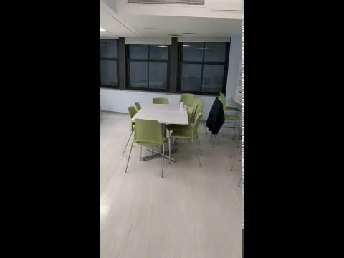
Sample Video to extract images

Slide 29
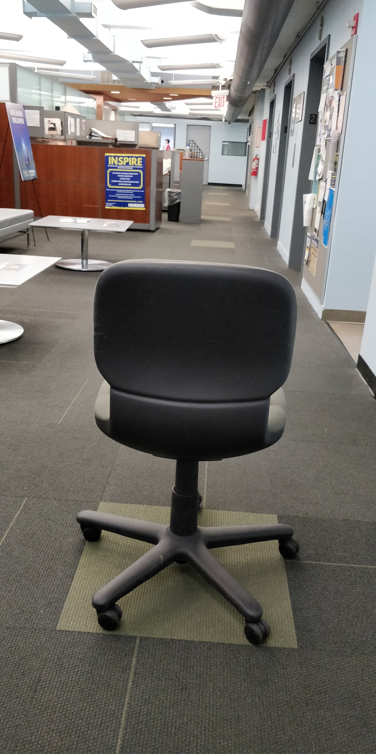
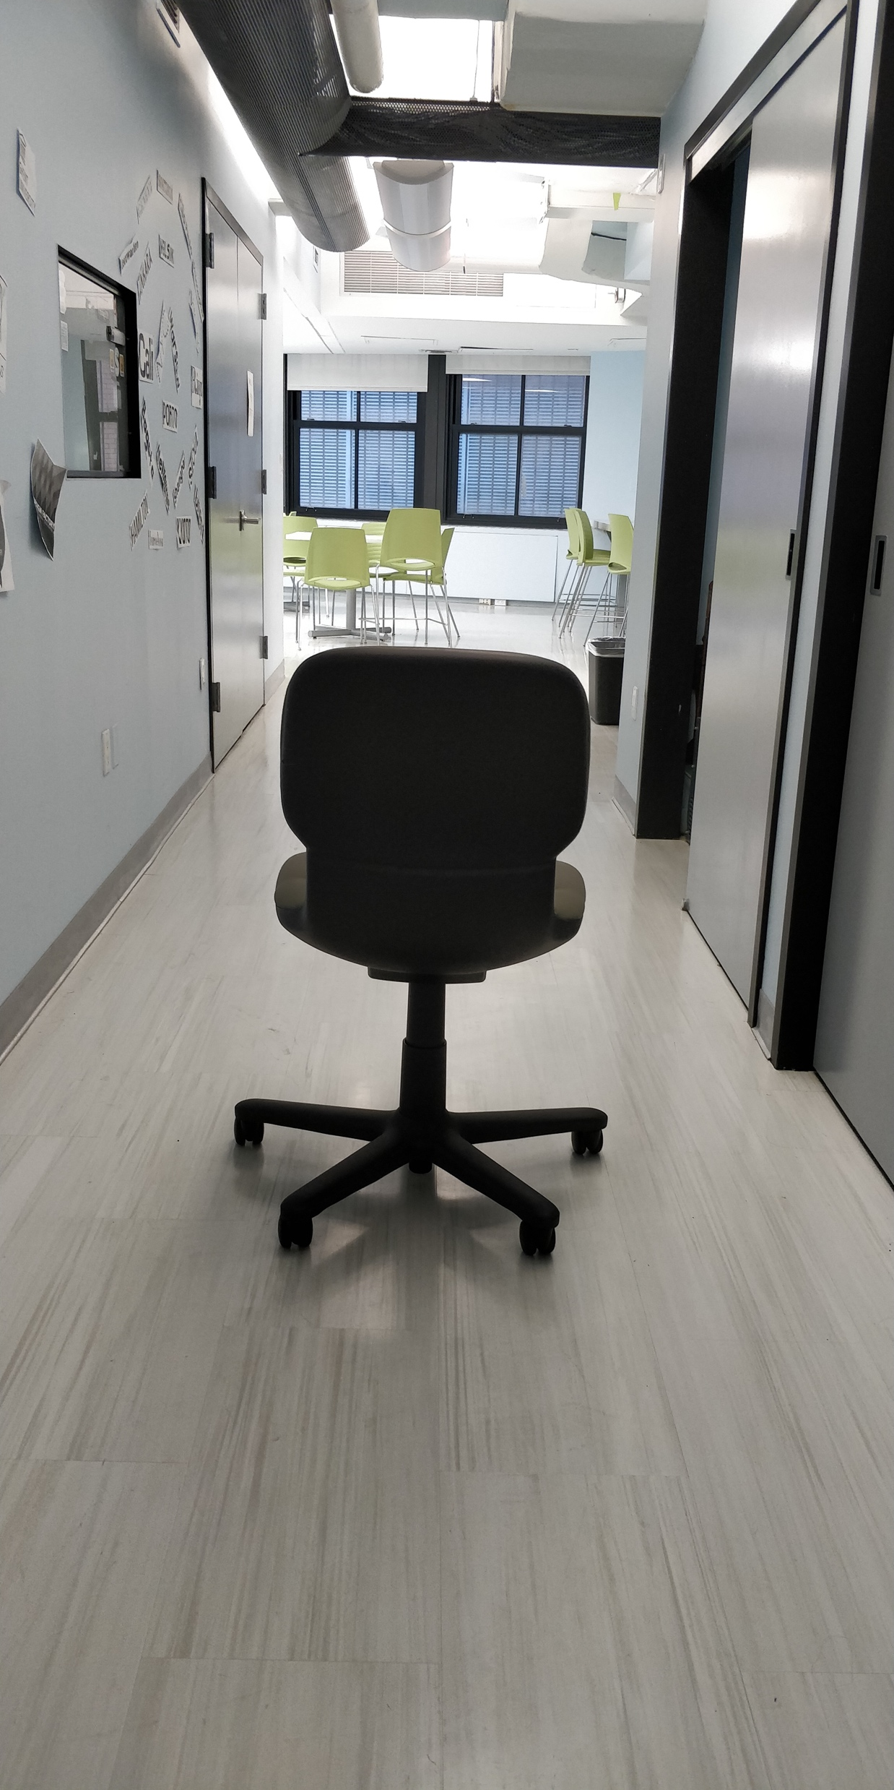
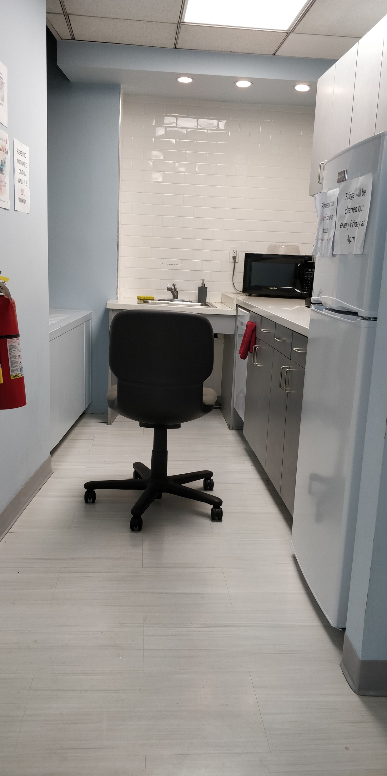
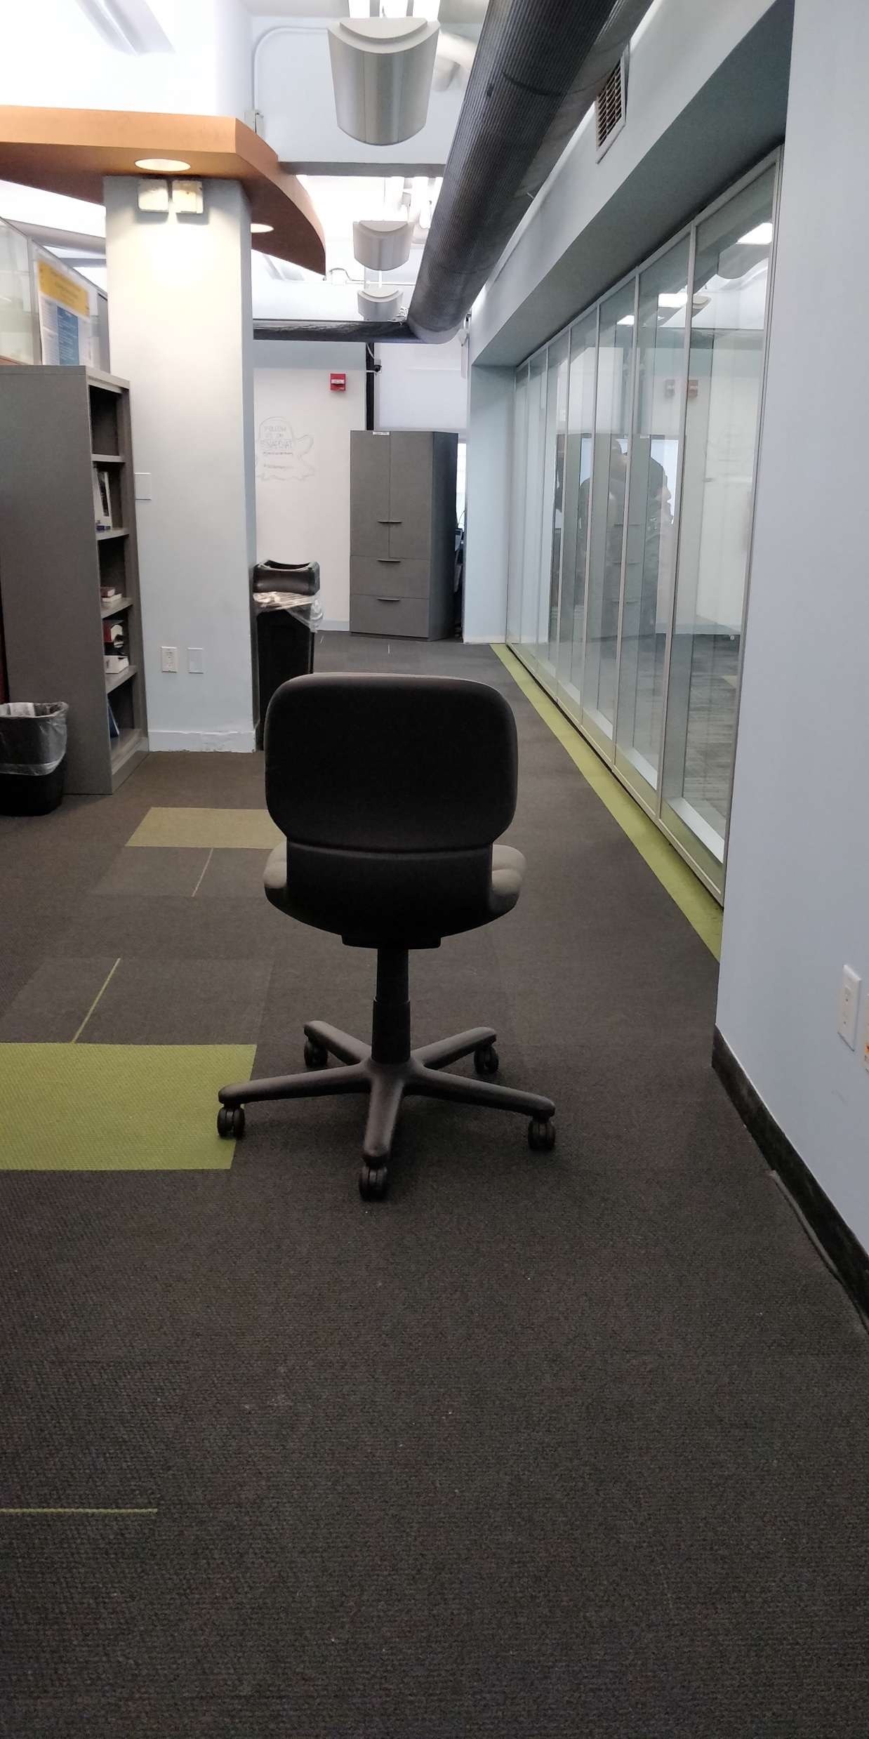
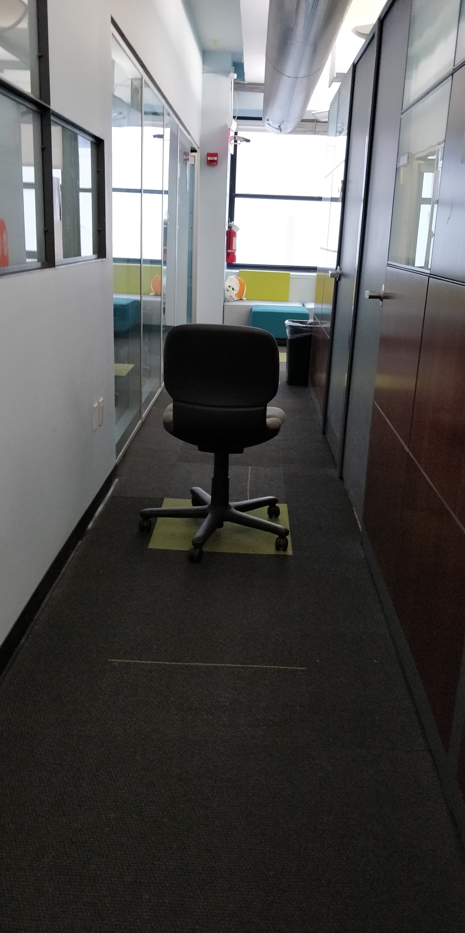
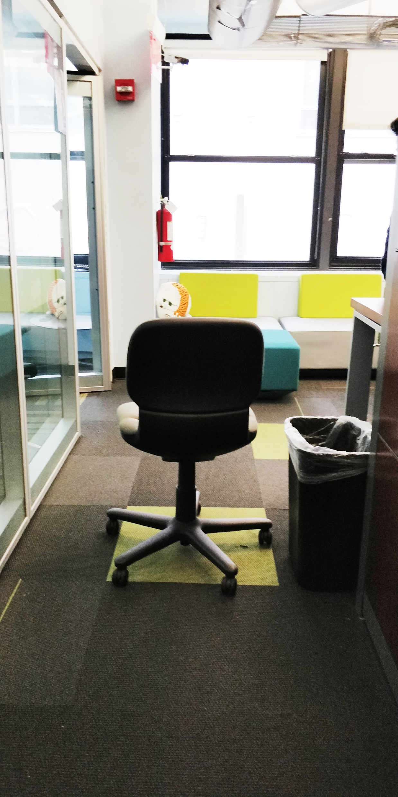
Sample Images Extracted and labeled

Slide 30






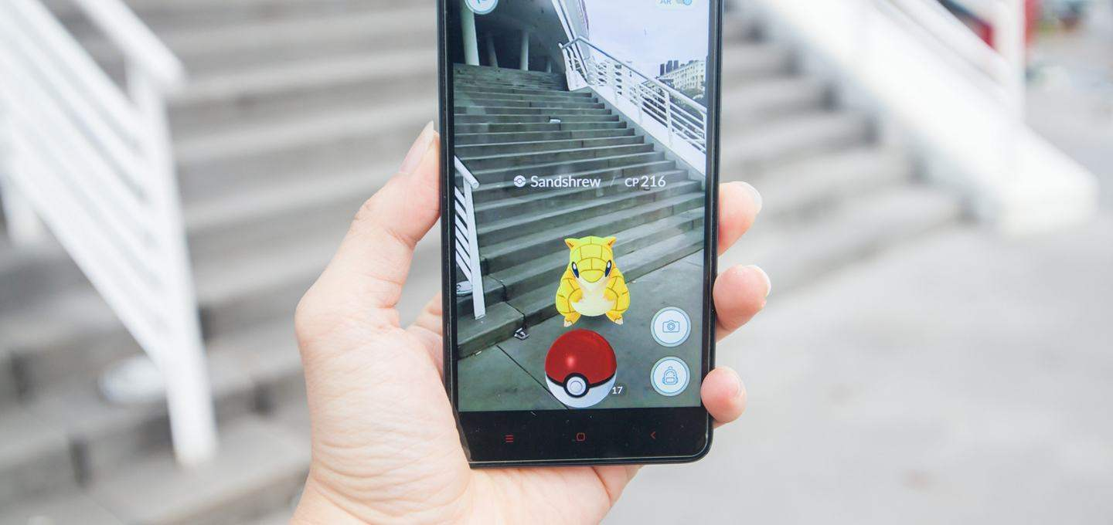

Technology Used

Slide 31
Architecture Diagram
Training Phase
Deep Convolutional Neural Network
extract
Images with label
training
Videos
Service Phase
Room level model for level area recognition
Sent
Input Photo
to model

Slide 32
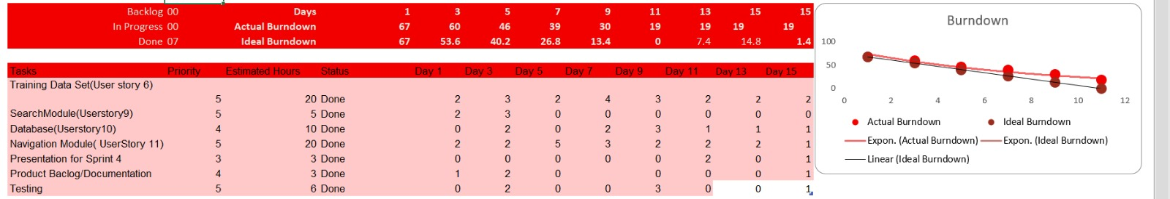
Burn Down Chart (SPRINT3)

Slide 33
THANK YOU

